Slide 1



Philippines-2019-events-data Typhoons Analysis
View in Power BI
Last data refresh:
9/1/2022 12:39:36 AM UTC
Downloaded at:
1/19/2023 4:03:13 AM UTC

Slide 2
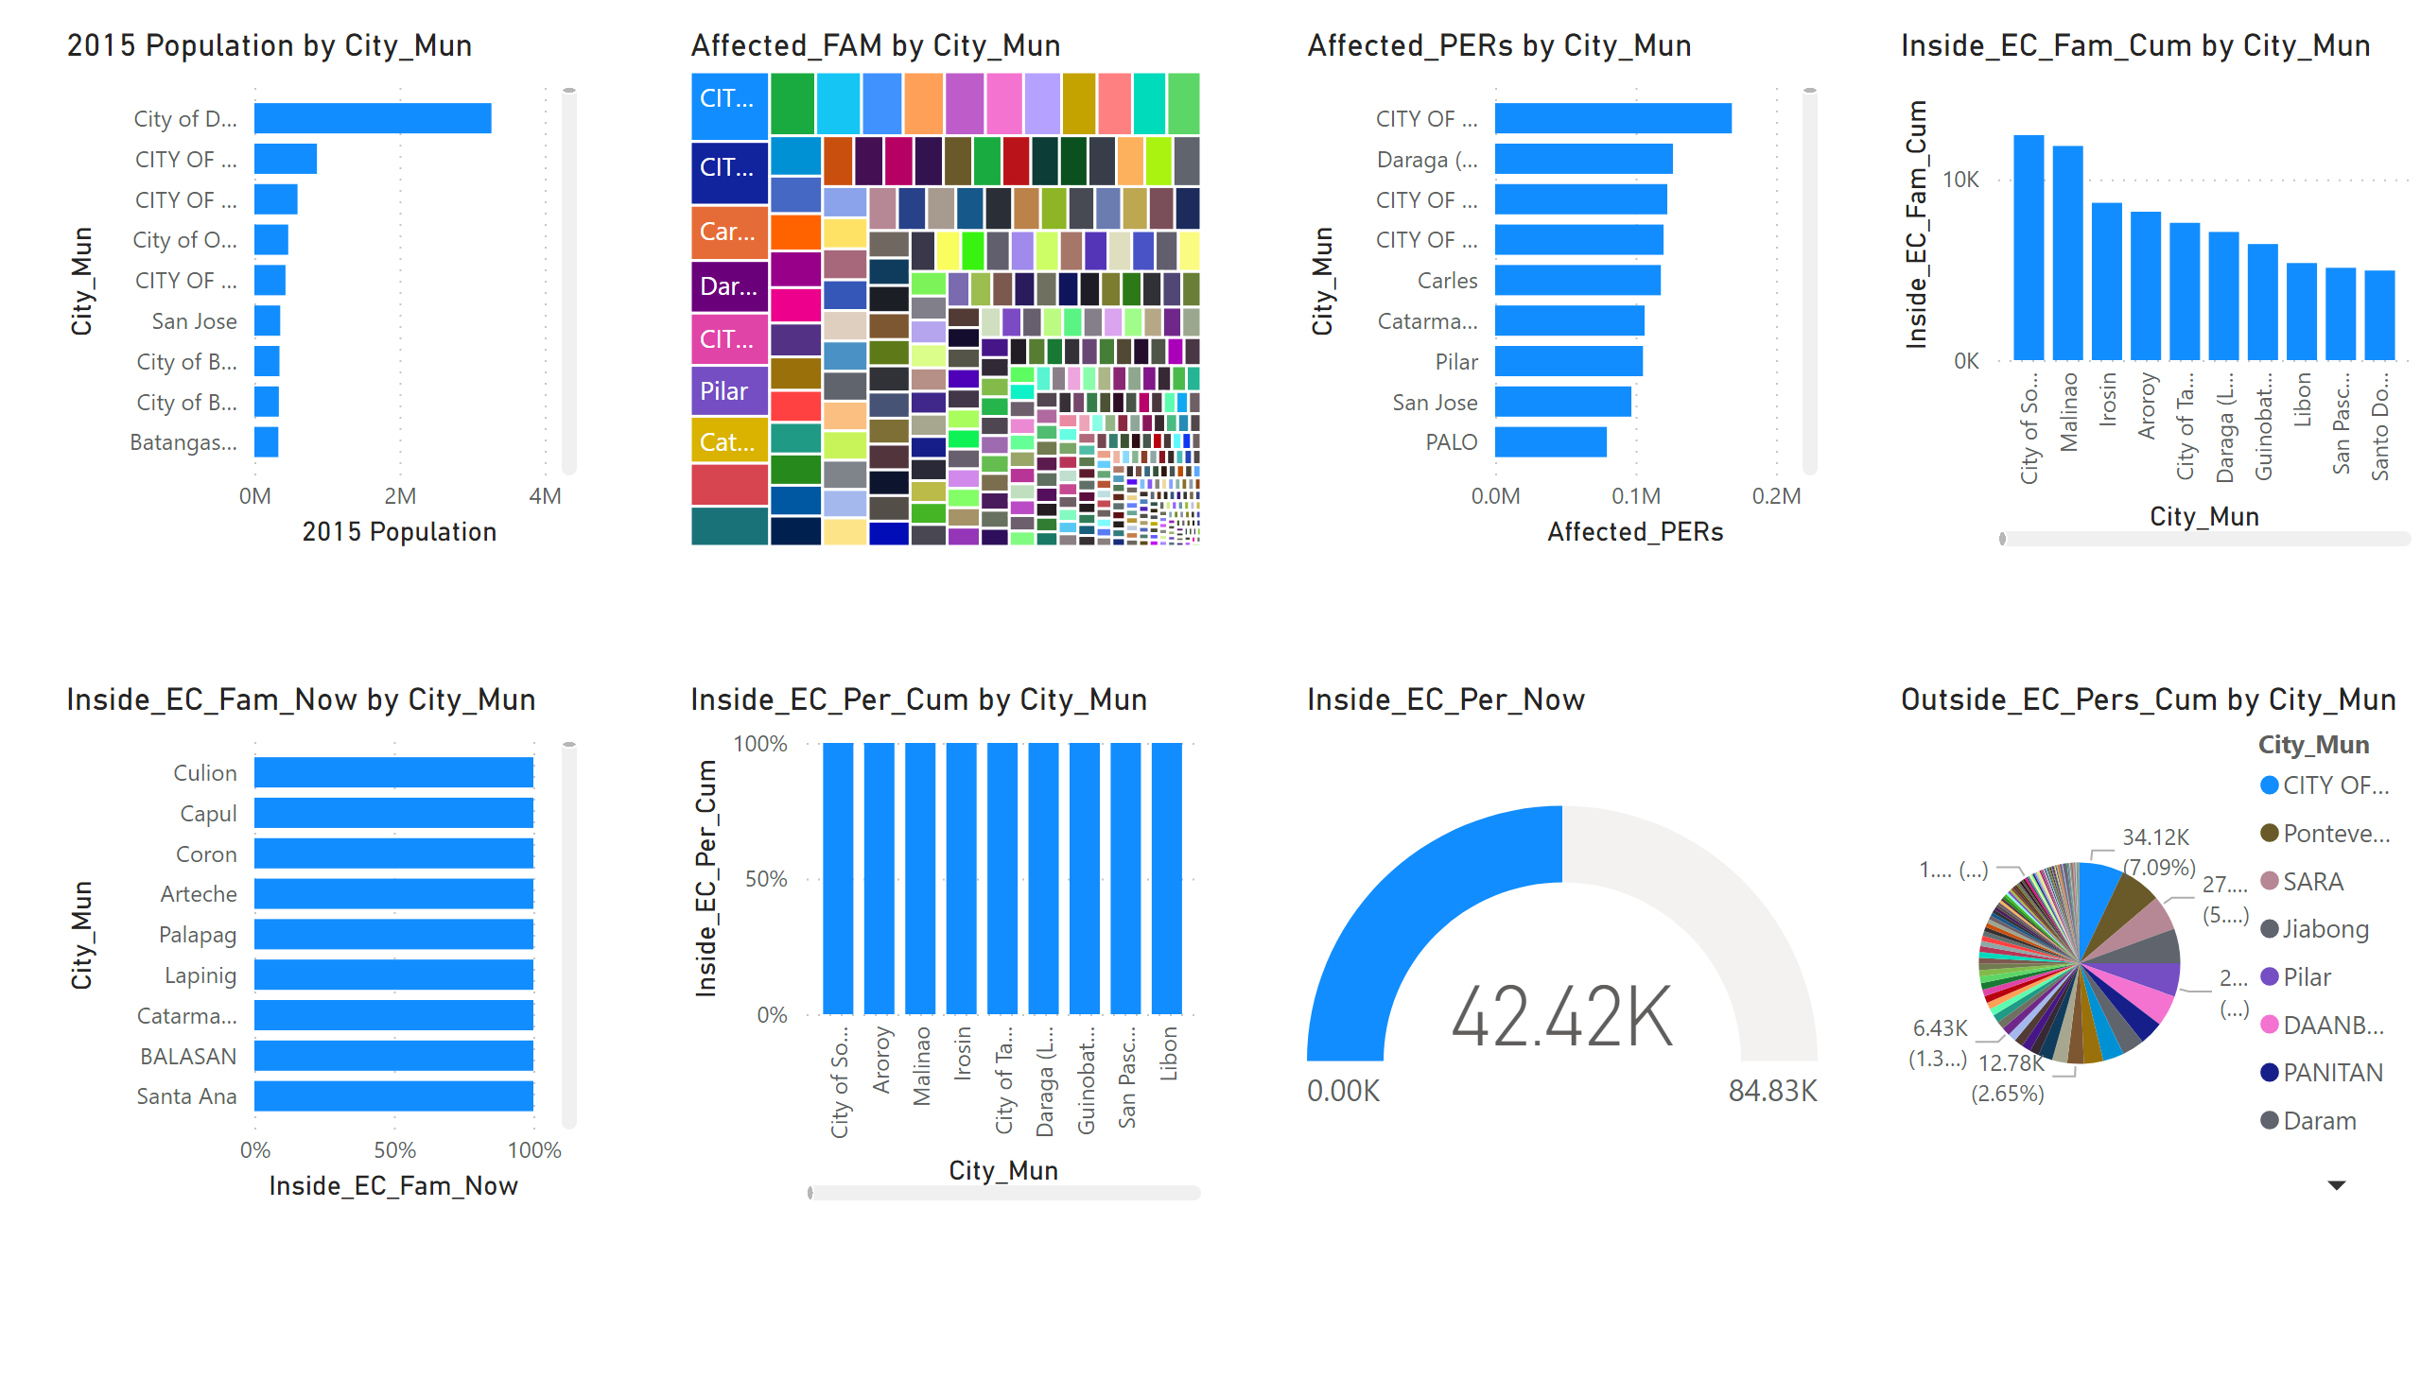
Page 1
Notes:
treemap
No alt text provided
pieChart
No alt text provided
gauge
No alt text provided
hundredPercentStackedColumnChart
No alt text provided
hundredPercentStackedBarChart
No alt text provided
clusteredColumnChart
No alt text provided
clusteredBarChart
No alt text provided
barChart
No alt text provided

Slide 3
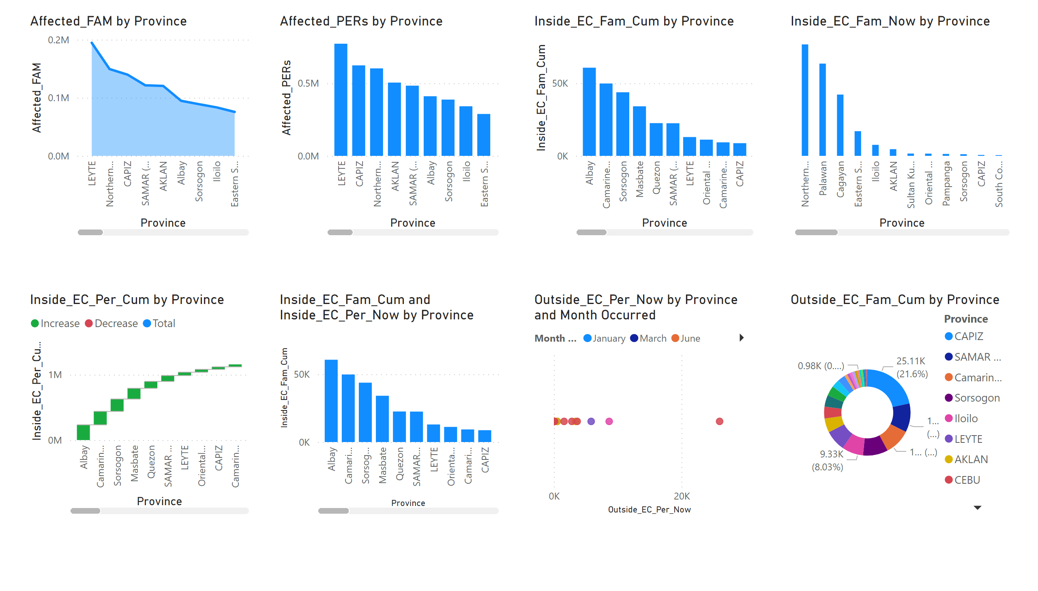
Page 2
Notes:
donutChart
No alt text provided
scatterChart
No alt text provided
lineStackedColumnComboChart
No alt text provided
waterfallChart
No alt text provided
ribbonChart
No alt text provided
lineClusteredColumnComboChart
No alt text provided
lineStackedColumnComboChart
No alt text provided
stackedAreaChart
No alt text provided

